Slide 1
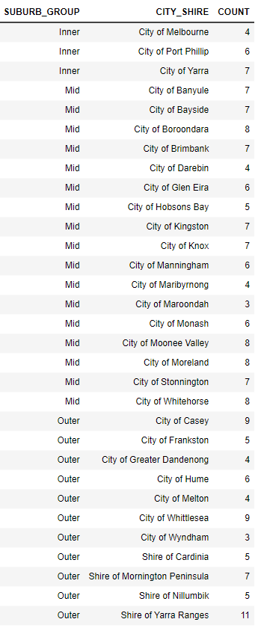
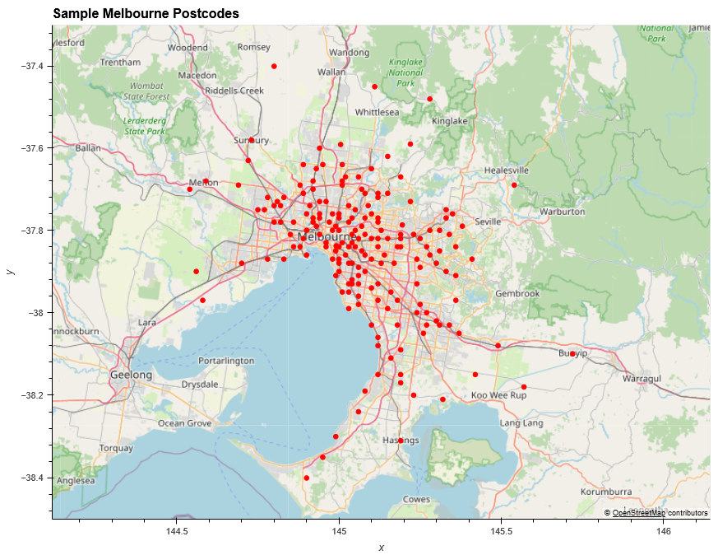
Melbourne Postcodes Sample size = 192
Sample chosen based on available data points from the various data sources.
Restricted to City-Shires within Melbourne

Slide 2
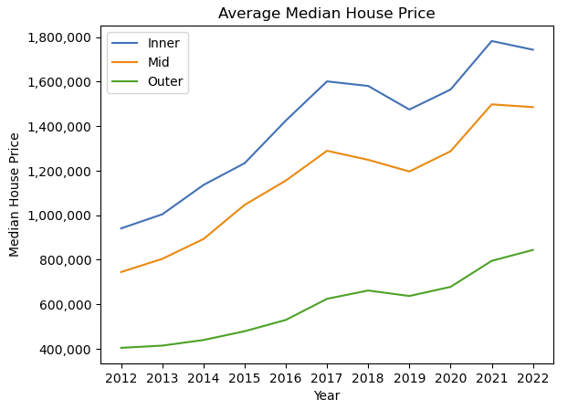
Median House Price – which postcodes are most affordable?
Upward trend in median house price from 2012 to 2022
Impact of covid apparent on all areas of Melbourne
Decline in Median House Price For Inner and Mid areas, whereas Outer increasing from 2021 to 2022
????
covid

